Slide 1
Optimization Process and Standard Error
Kyun-Seop Bae MD PhD
Department of Clinical Pharmacology and Therapeutics
University of Ulsan

Slide 2
(Mathematical) Optimization
Objective Function: Function to be optimized
Optimization: Maximization or Minimization
Has many subfields: see Wikipedia
Complex, evolving, applicable to many fields
Some famous ones
Nelder-Mead Simplex method
Newton type gradient based methods: DFP, BFGS, CG, L-BFGS-B
SANN: simulated-annealing method
Genetic algorithm
R base package has optim(), optimize(), nlm(), nlminb().
Many issues like saddle point, local minima, …

Slide 3
Optimization in NONMEM
NONMEM Users Guide I, p3
“The numerical search is implemented according to an algorithm by R.A. Fletcher, 1972, modified by IMSL (whose code forms the basis for the NONMEM code), and further modified by the NONMEM Project. This algorithm is a derivative-free quasi-Newton type minimization algorithm for an arbitrary objective function. It is presumed that the user has some familiarity with the types of numerical problems that can be encountered with minimization algorithms.”
Newton type: using gradient and hessian
Quasi-Newton: approximate hessian is used and updated
Derivative free: user does not need to provide gradient function
Most Popular ones: DFP and BFGS (a kind of variable metric method)

Slide 4
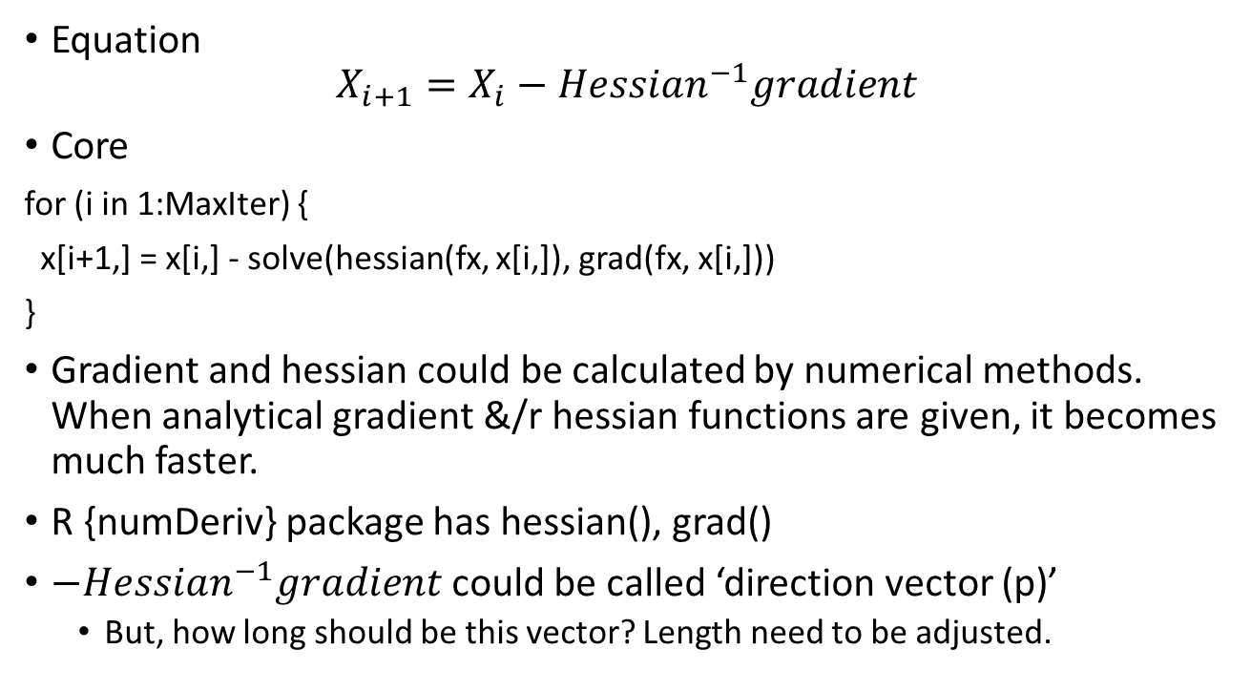
Newton method
Equation
$$X_{i+1}=X_{i}−{Hessian}^{−1}gradient$$
Core
for (i in 1:MaxIter) {
x[i+1,] = x[i,] - solve(hessian(fx, x[i,]), grad(fx, x[i,]))
}
Gradient and hessian could be calculated by numerical methods. When analytical gradient &/r hessian functions are given, it becomes much faster.
R {numDeriv} package has hessian(), grad()
$−{Hessian}^{−1}gradient$ could be called ‘direction vector (p)’
But, how long should be this vector? Length need to be adjusted.

Slide 5
Basic Terms
Differentiation of scalar valued function w.r.t vector → gradient (vector)
Further differentiation of gradient w.r.t vector → Hessian (matrix)
Differentiation of vector valued function w.r.t vector → Jacobian (matrix)

Slide 6
Termination Criteria
There is no more change in the objective function value (OFV, y)
There is no more difference in x values
The gradients are almost zeros.
Most software use only the first one as the criterion of success.
NONMEM® uses another criterion: SIGDIG
Rounding error: no better x could be found
Minimization failure is frequent phenomenon.

Slide 7
SIGDIG in NONMEM® (in UCP/STP scale)
0.0000E+00 0.0000E+00 0.0000E+00 0.0000E+00 0.0000E+00
-0.2268E+01 -0.2513E+01 -0.2309E+01 -0.1933E+01 -0.1469E+01
-0.2215E+01 -0.1712E+01 -0.1724E+01 -0.1921E+01 -0.2502E+01
-0.1513E+01 -0.6113E+00 -0.1353E+01 -0.6891E+00 -0.4158E+00
-0.4721E+00 -0.4085E+00 -0.5837E+00 0.1889E+00 0.1265E+00
-0.2128E+00 0.1030E+01 0.3951E+00 0.4544E+00 0.5877E+00
0.1470E+01 0.2285E+01 0.2069E+01 0.2908E+01 0.2657E+01
0.2642E+01 0.2174E+01 0.3156E+01 0.1737E+01 0.2576E+01

Slide 8
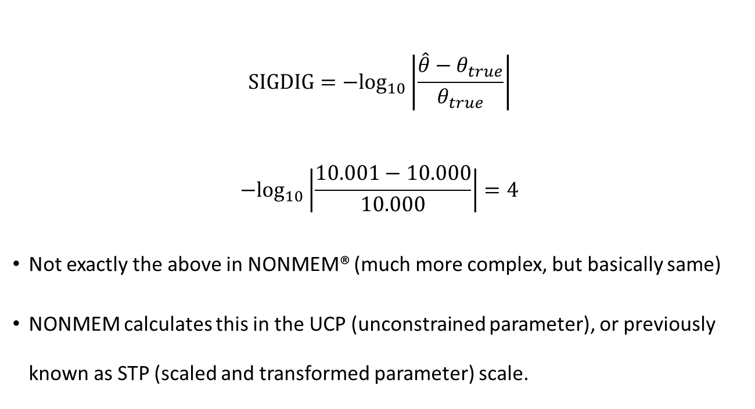
Redefined SIGDIG
$$SIGDIG={−log}_{10}\left|\frac{\hat{θ}−θ_{true}}{θ_{true}}\right|$$
$${−log}_{10}\left|\frac{10.001−10.000}{10.000}\right|=4$$
Not exactly the above in NONMEM® (much more complex, but basically same)
NONMEM calculates this in the UCP (unconstrained parameter), or previously known as STP (scaled and transformed parameter) scale.

Slide 9
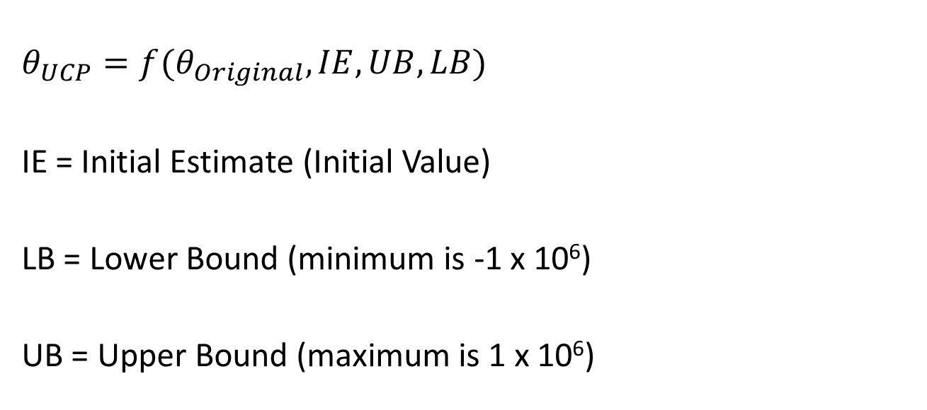
UCP (STP) for Theta
$$θ_{UCP}=f(θ_{Original},IE, UB,LB)$$
IE = Initial Estimate (Initial Value)
LB = Lower Bound (minimum is -1 x 10⁶)
UB = Upper Bound (maximum is 1 x 10⁶)

Slide 10
UCP for Omega and Sigma
ScaleFactor = f(chol(Matrix.original))
Matrix.UCP = f(Matrix.original, ScaleFactor)

Slide 11
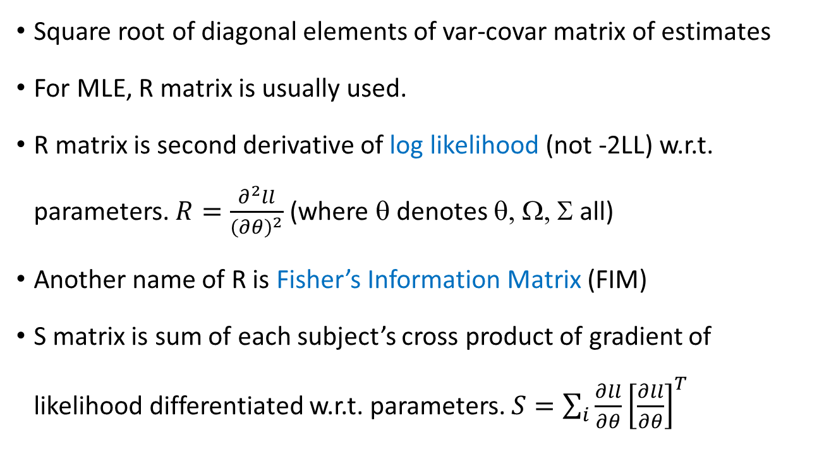
R matrix and S matrix
Square root of diagonal elements of var-covar matrix of estimates
For MLE, R matrix is usually used.
R matrix is second derivative of log likelihood (not -2LL) w.r.t. parameters. $R=\frac{∂^{2}ll}{{\left(∂θ\right)}^{2}}$ (where θ denotes θ, Ω, Σ all)
Another name of R is Fisher’s Information Matrix (FIM)
S matrix is sum of each subject’s cross product of gradient of likelihood differentiated w.r.t. parameters. $S=\sum_{i}{\frac{∂ll}{∂θ}{\left[\frac{∂ll}{∂θ}\right]}^{T}}$

Slide 12
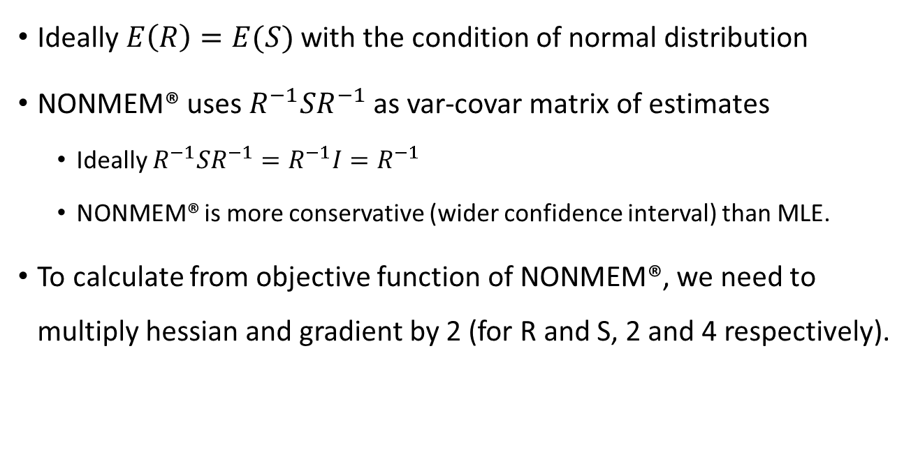
Standard Errors of Estimates
Ideally $E\left(R\right)=E(S)$ with the condition of normal distribution
NONMEM® uses $R^{−1}SR^{−1}$ as var-covar matrix of estimates
Ideally $R^{−1}SR^{−1}=R^{−1}I=R^{−1}$
NONMEM® is more conservative (wider confidence interval) than MLE.
To calculate from objective function of NONMEM®, we need to multiply hessian and gradient by 2 (for R and S, 2 and 4 respectively).

